Slide 1

Numbers Up to 99
In today’s session we are going to
Count till 100
Make numbers up to 99
Read and write the numbers and their number names.

Slide 2
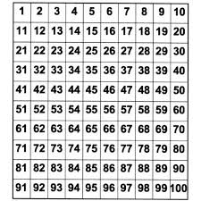
Start counting from 1….
Let’s start our class with a counting activity.

Slide 3

That was brilliant work kids. Now let’s find the missing numbers
Shall we start doing the worksheet???
https://www.liveworksheets.com/xu351235dk

Slide 4

That was amazing kids. Now you know the numbers till 100.

Slide 5


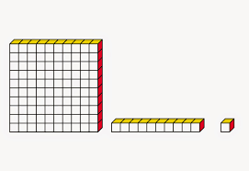
Come let’s start making numbers using dienes blocks.
Ones cube
10 ones = 1 ten
Tens strip
10 tens = 1 hundred

Slide 6
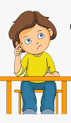
Take a look at how number 43 is formed.
This shows 43 has 4 tens and 3 ones
We read it as 43.
Tens | Ones
4 | 3
A worksheet to workout
https://www.liveworksheets.com/cr350930eh

